Slide 1
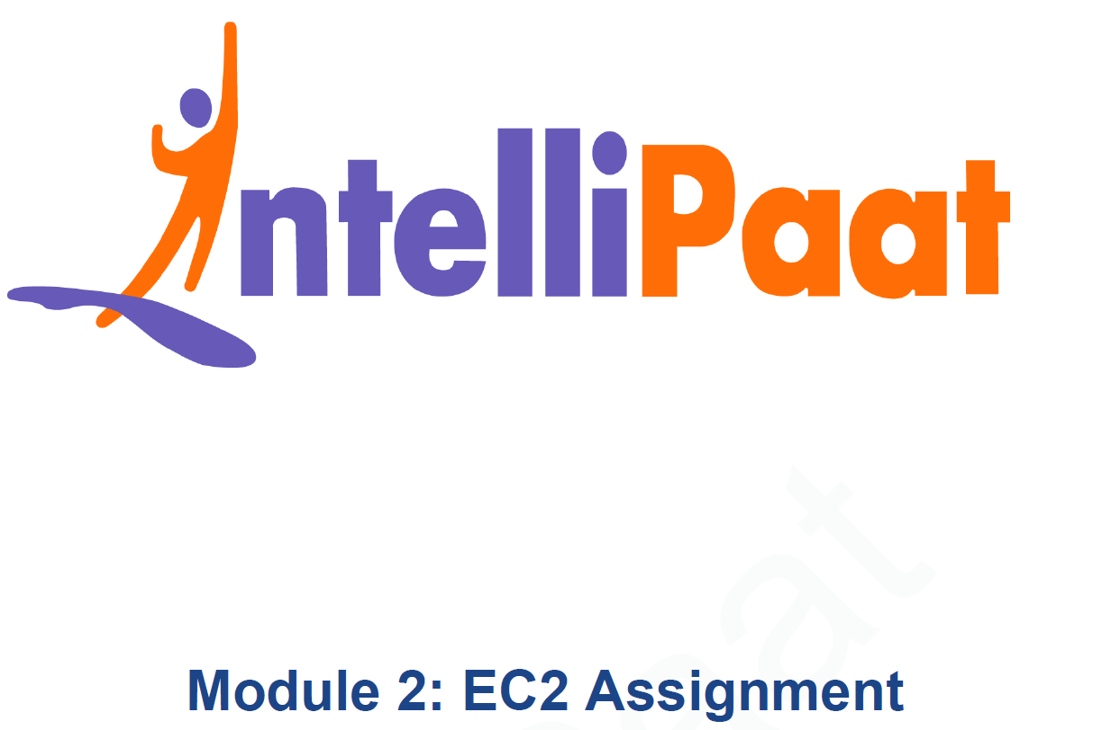
AWS Solutions Architect Training
Module-3: CloudWatch
SIDDHANI VAMSI SAI KUMAR
svsk2376@gmail.com
7678203747

Slide 2
You work for XYZ Corporation. To maintain the security of the AWS account and the resources you have been asked to implement a solution that can help easily recognize and monitor the different users. Also, you will be monitoring the machines created by these users for any errors or misconfigurations.
Dashboard Tasks:
Create a dashboard which lets you check the CPU utilization and networking for a particular EC2 instance.
Alarm Tasks:
Create a CloudWatch billing alarm which goes off when the estimated charges go above $500.
Create a CloudWatch alarm which goes off to an Alarm state when the CPU utilization of an EC2 instance goes above 65%. Also add an SNS topic so that it notifies the person when the threshold is crossed.
Problem Statement:

Slide 3
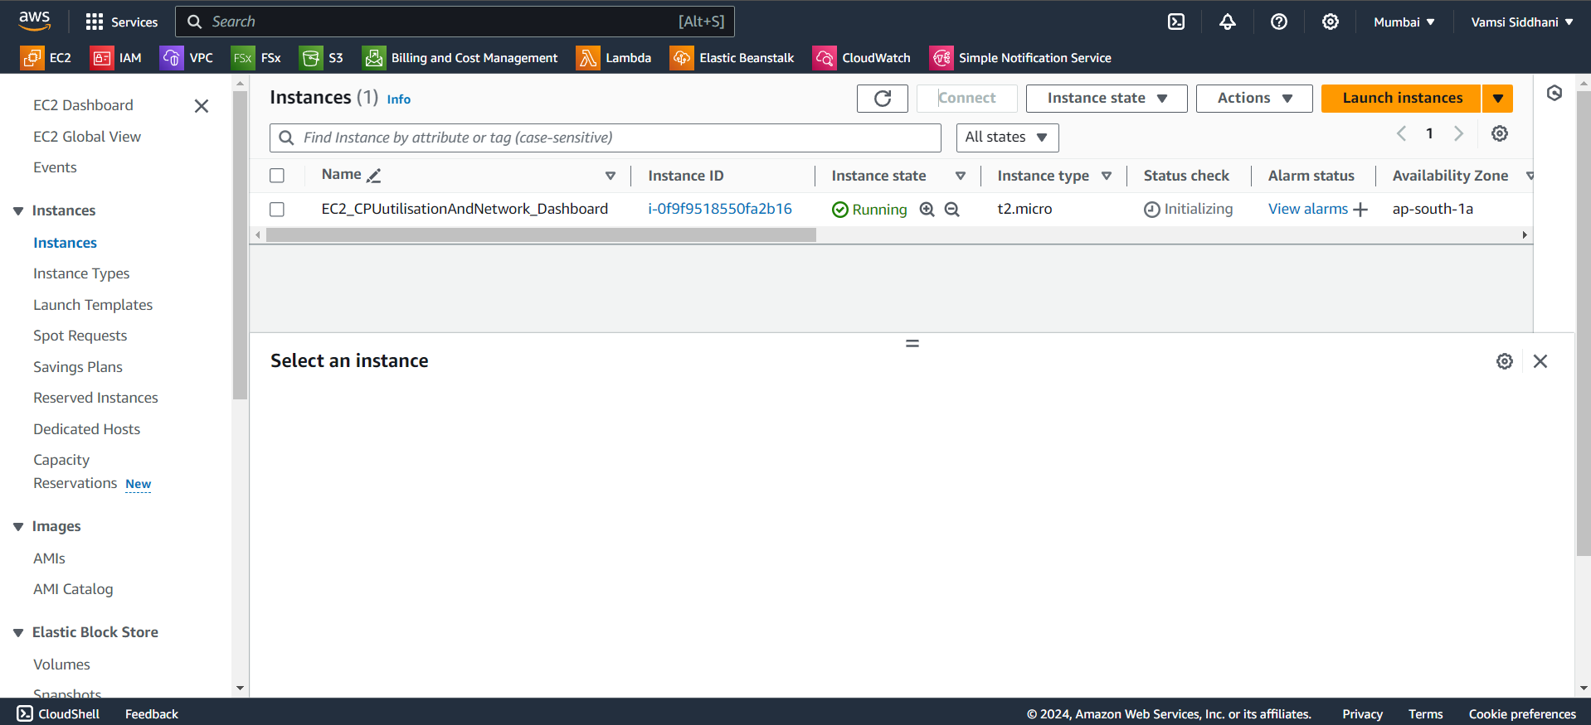
TASK – Dashboard
For task1, we need to create a CloudWatch dashboard for an EC2 instance. Let’s create it first.
Instance is ready. Let’s create a cloudwatch dashboard.

Slide 4
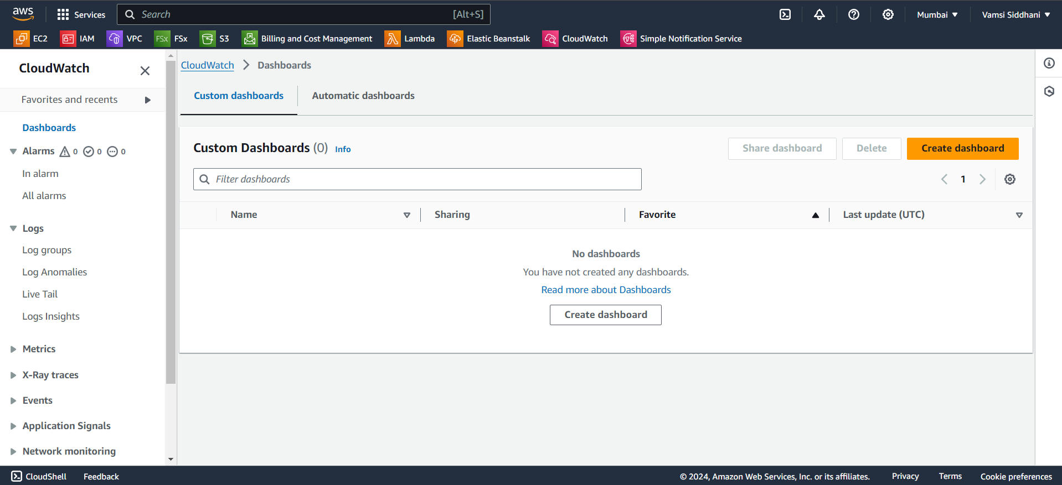
TASK – Dashboard
Open cloudwatch console and go to dashboards.
Click on create dashboard

Slide 5
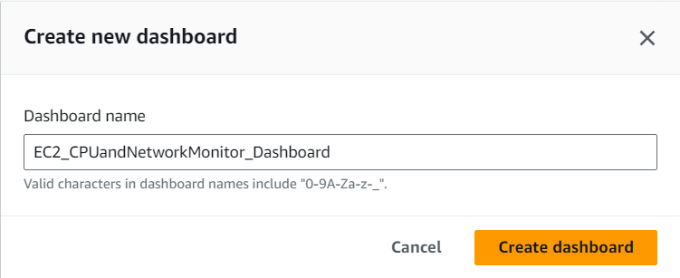
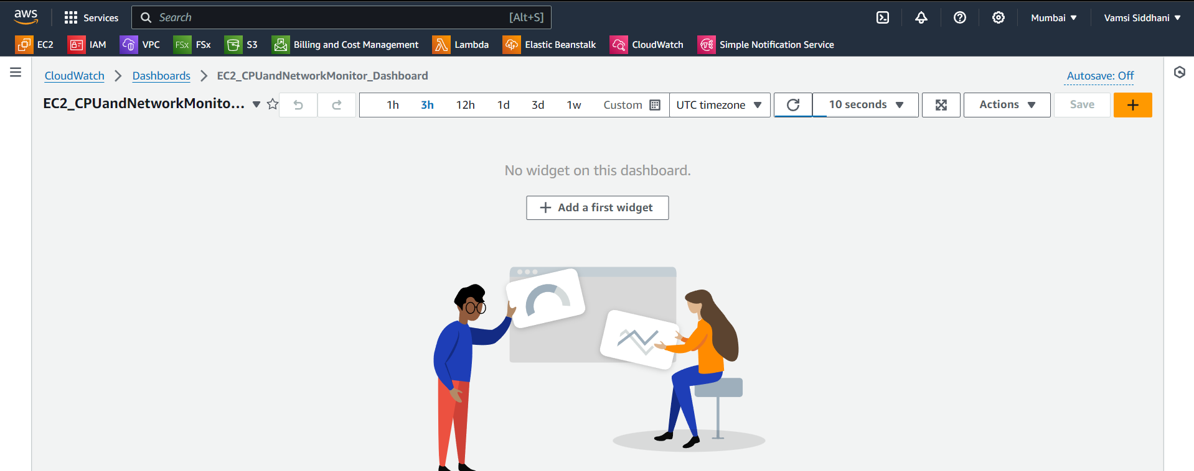
TASK – Dashboard
Give a name to dashboard and create.
Dashboard is created. Let’s add widgets to it. Click on Add.

Slide 6
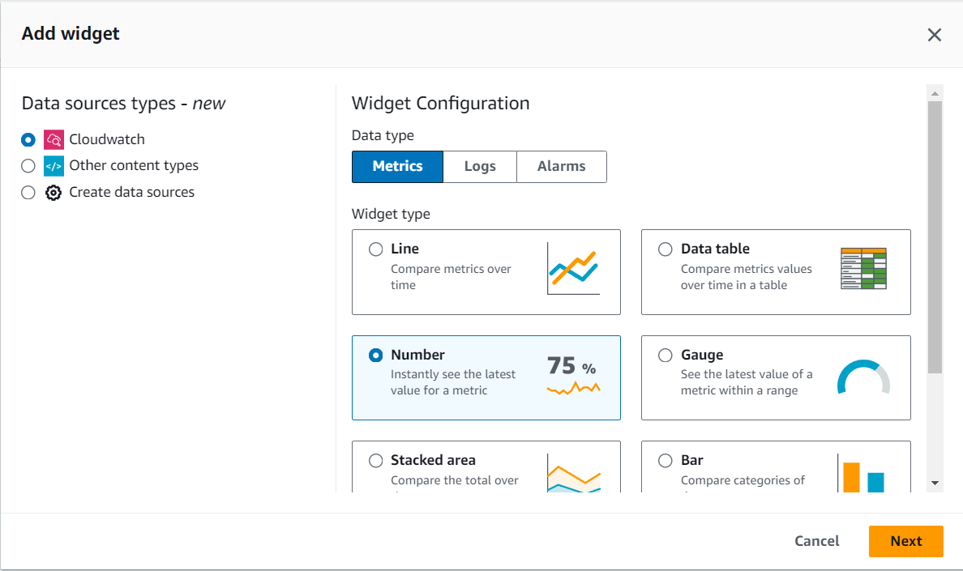
TASK – Dashboard
Select number as metric type and click on Next

Slide 7
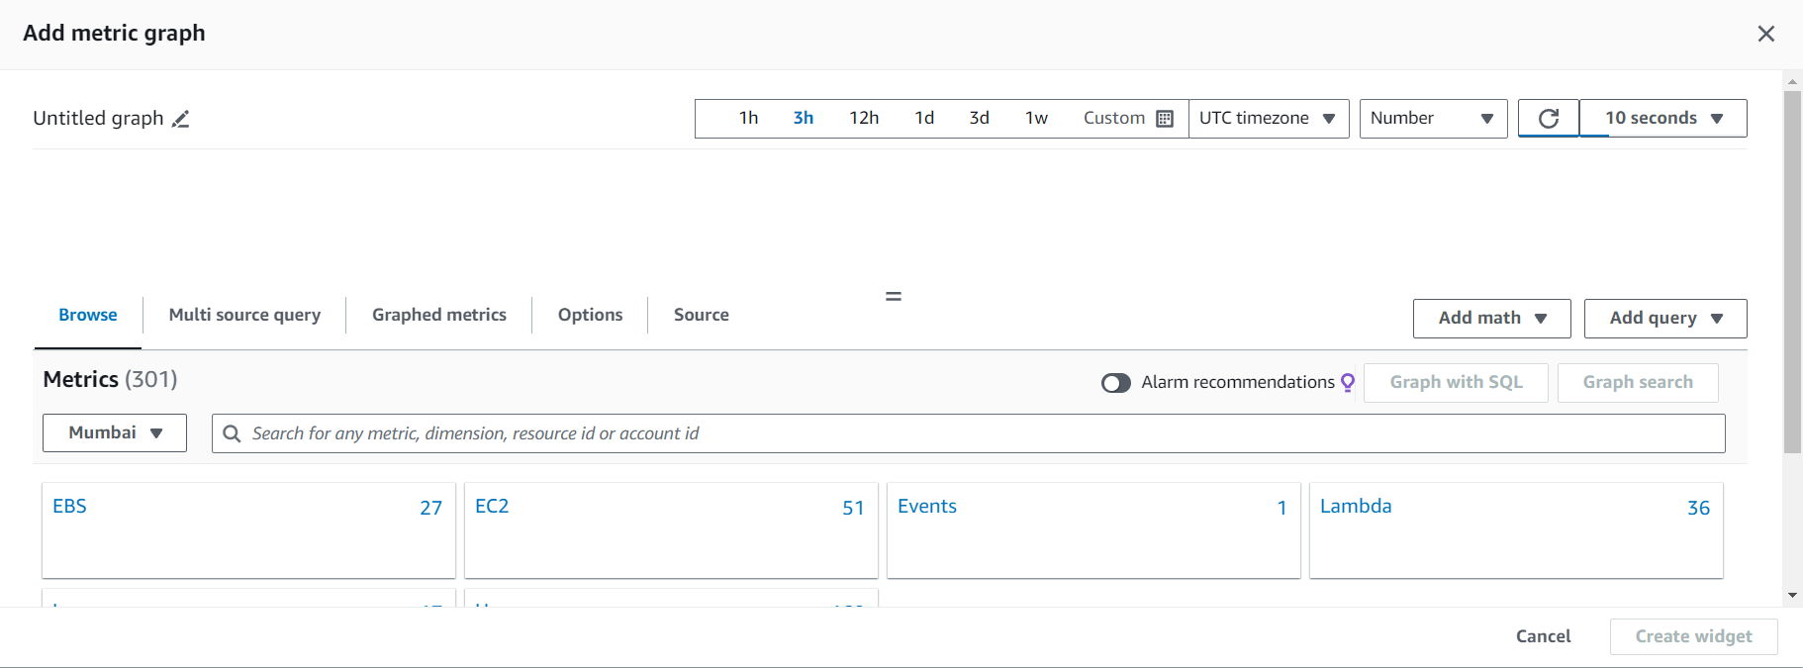
TASK – Dashboard
Choose EC2

Slide 8
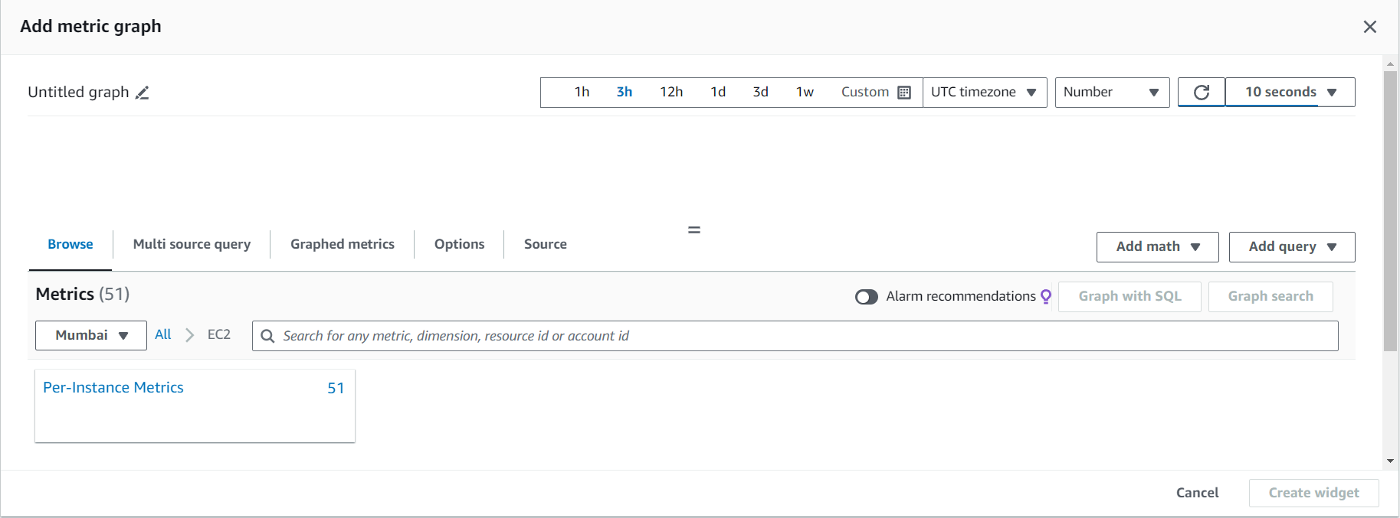
TASK – Dashboard
Select Per-Instance Metrics

Slide 9
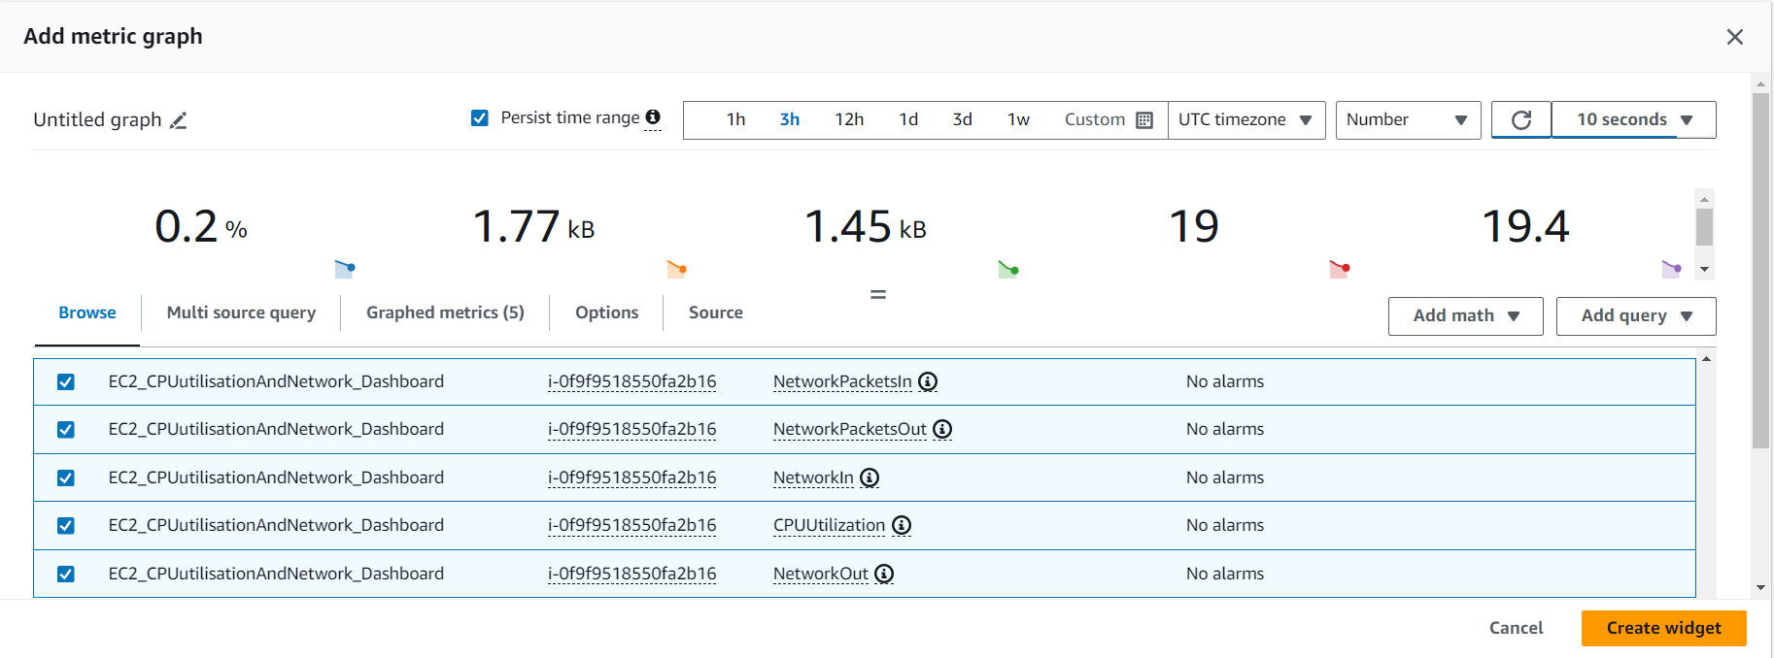
TASK – Dashboard
Select metrics related to CPU utilization and Network and create widget

Slide 10
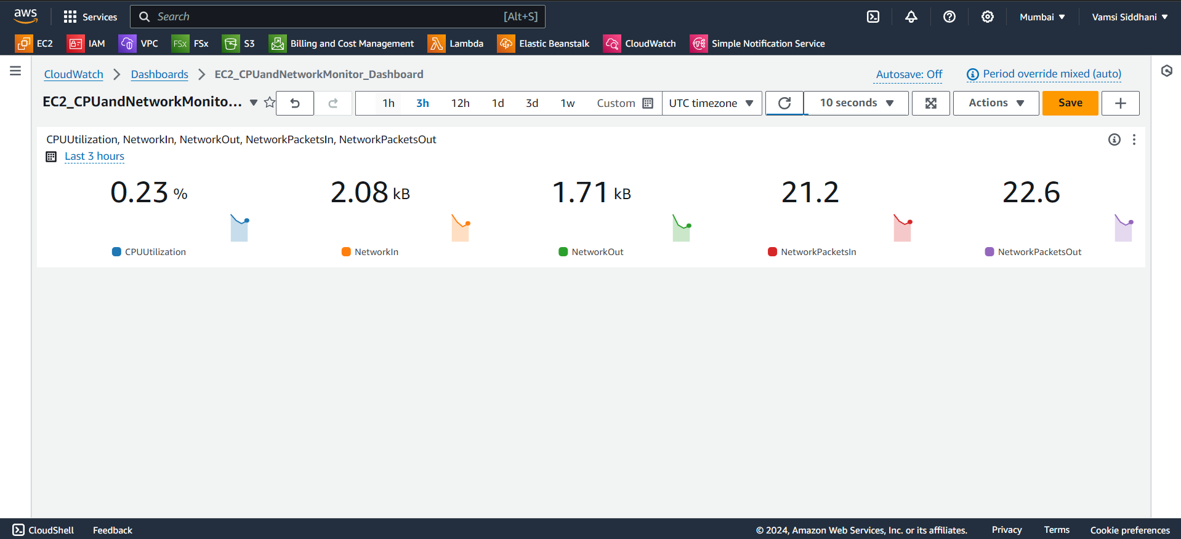
TASK – Dashboard
Widget is added to the dashboard.
Let’s move to the next task - Alarms

Slide 11
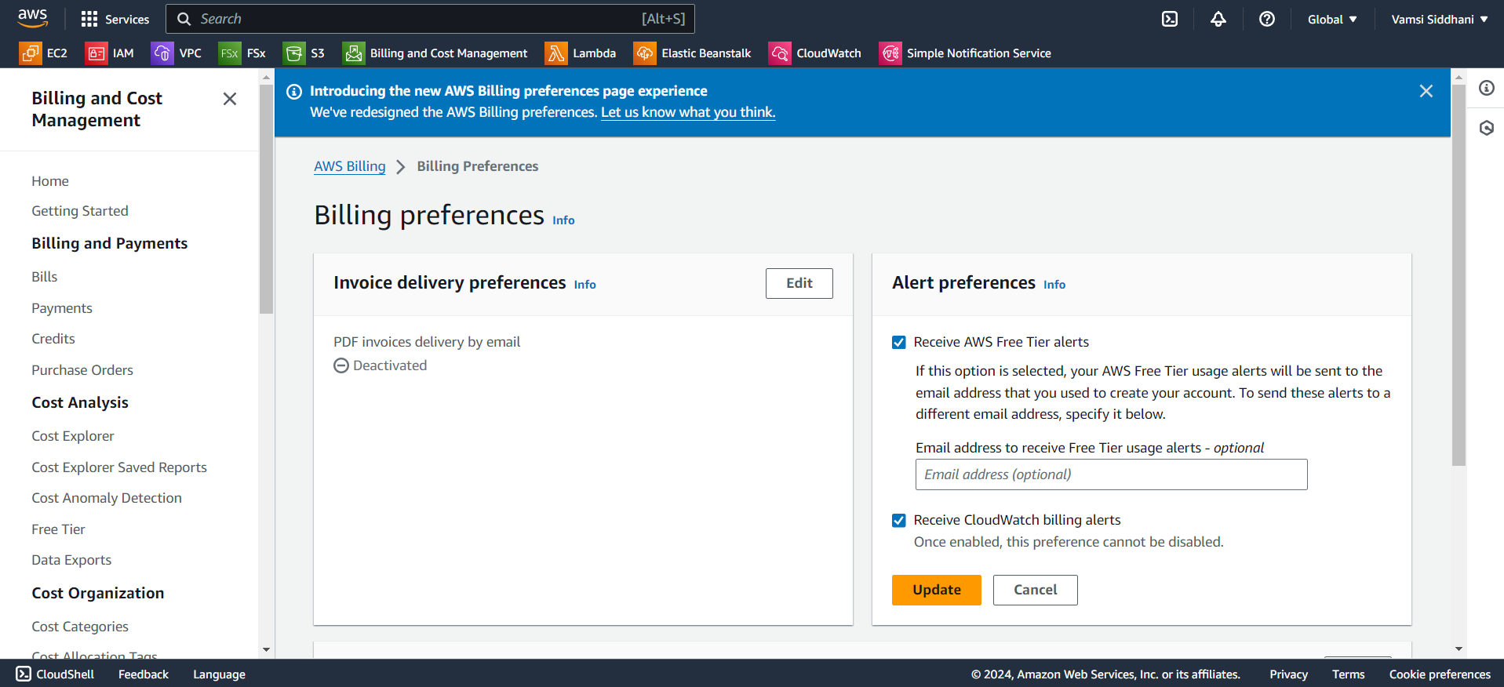
TASK – ALARMS
Let’s first enable billing alerts in order to create billing alarms.
Go to Billing and Cost Management → Billing Preferences.
Enable receive billing alerts and update.

Slide 12
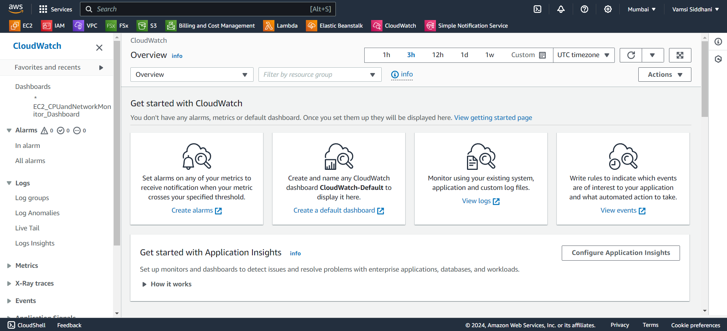
TASK – ALARMS
Go to cloudwatch dashboard and click on create alarms

Slide 13
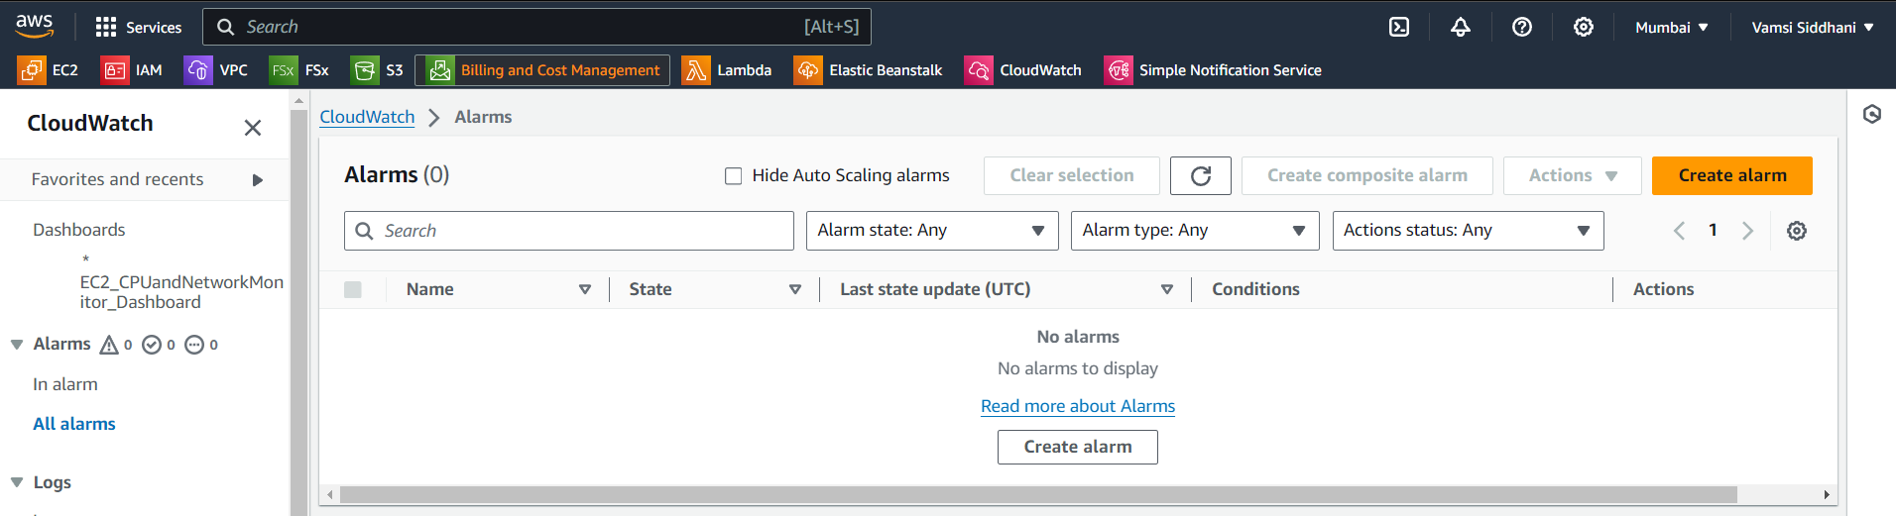
TASK – ALARMS
Click on create

Slide 14
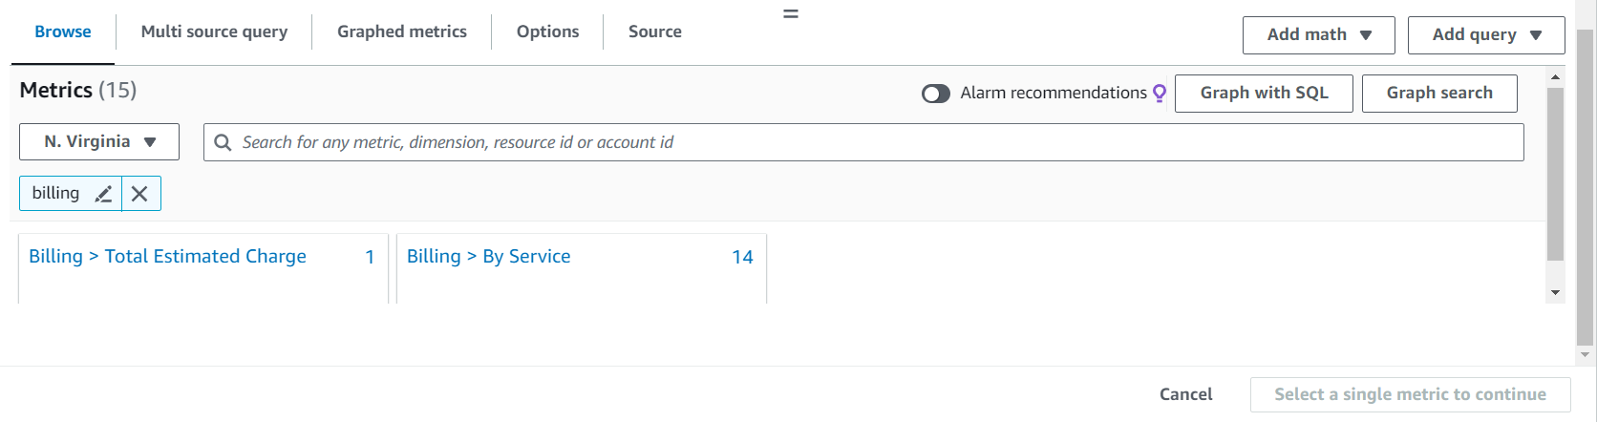
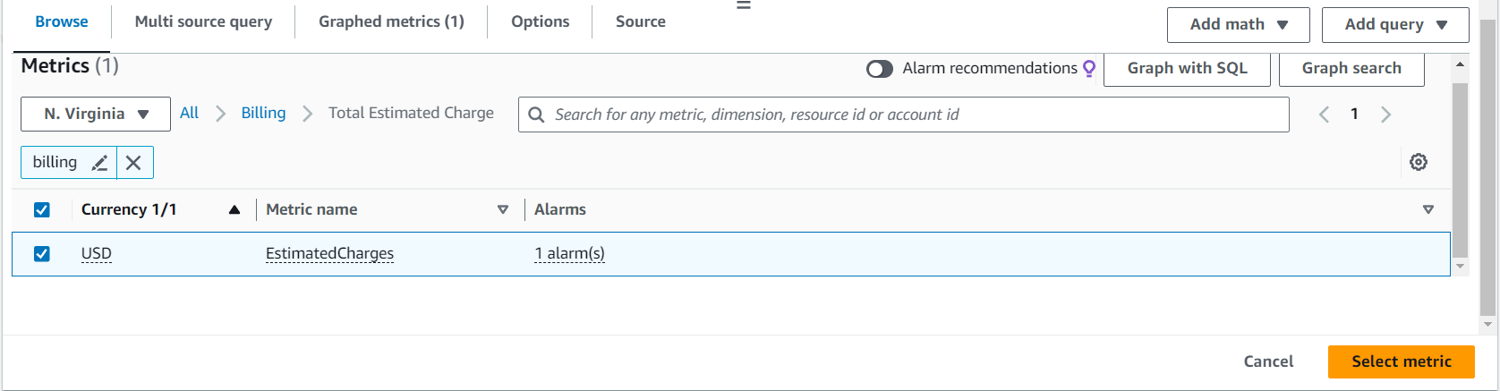
TASK – ALARMS
Search for billing and select Total Estimated Charge
Select USD and click on Select metric.

Slide 15
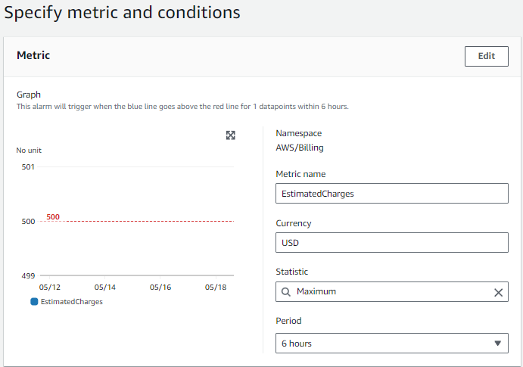
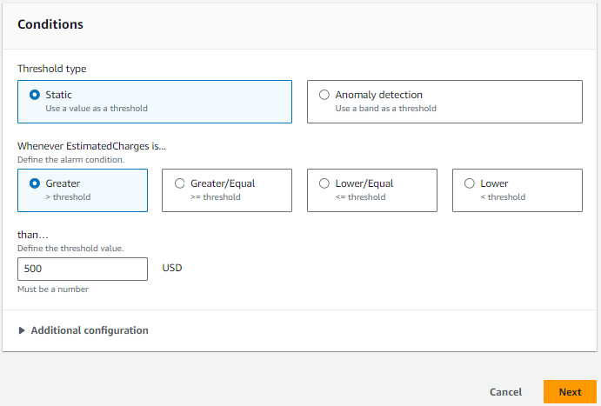
TASK – ALARMS
Alarm goes off when the estimated charges go above $500.
Click on Next

Slide 16
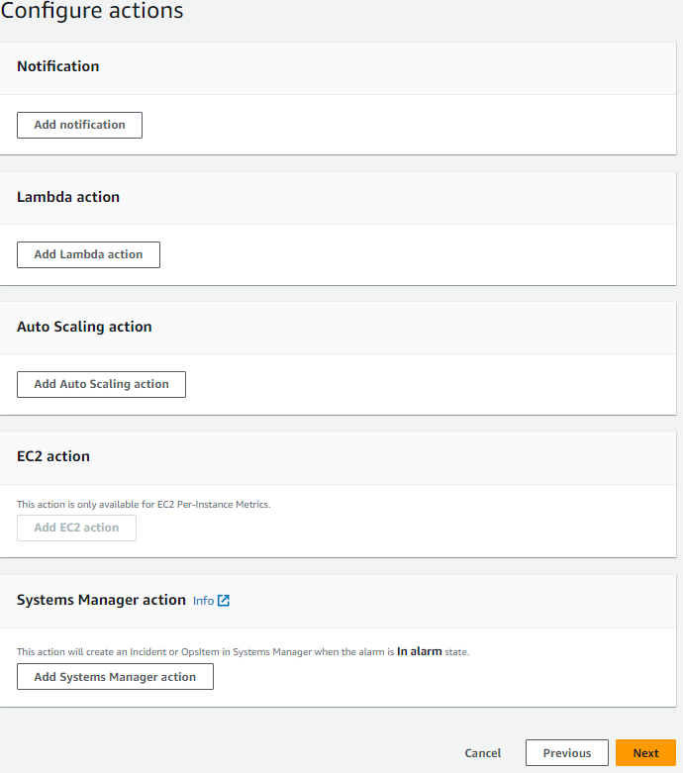
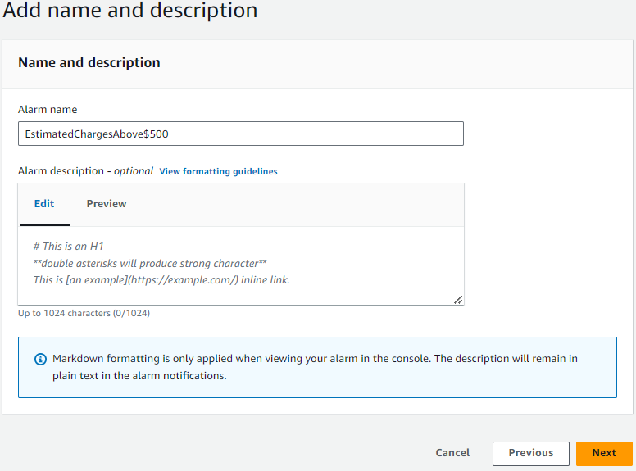
TASK – ALARMS
Remove notifications and click on Next
Give it a name and Click on Next
Review and create alarm.

Slide 17
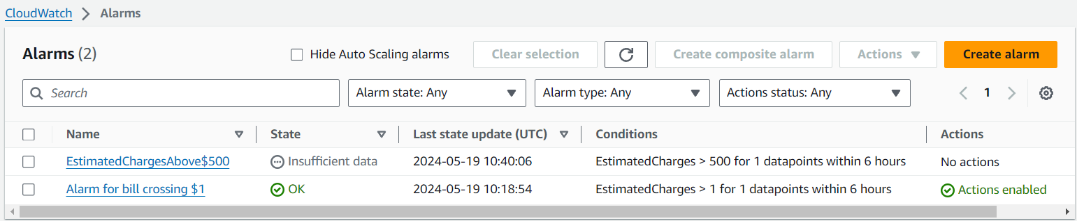
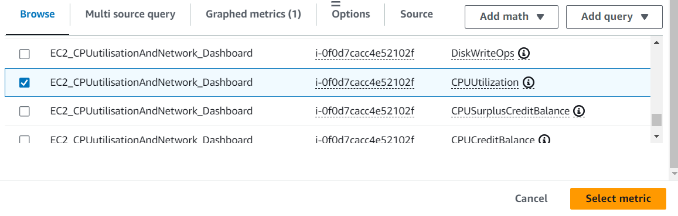
TASK – ALARMS
Alarm is created.
Lets create next alarm for CPU Utilization above 65% with an SNS topic.
Go to Create Alarms → Metric → EC2 → Per-Instance Metrics →
select CPU Utilization for the instance

Slide 18
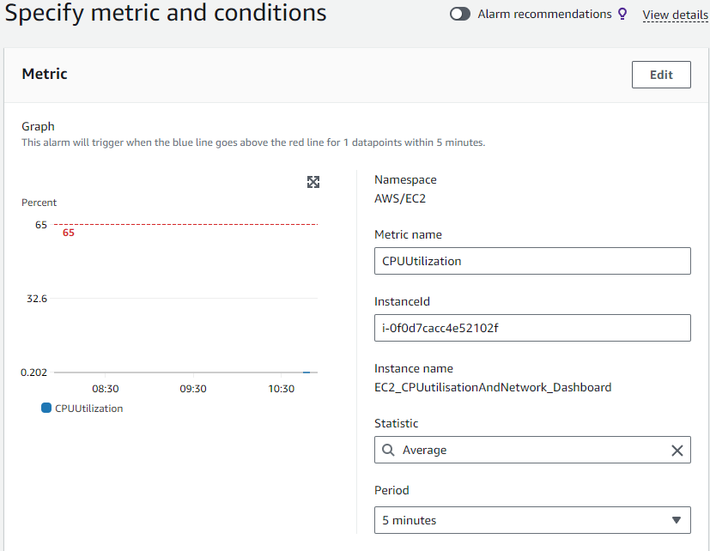
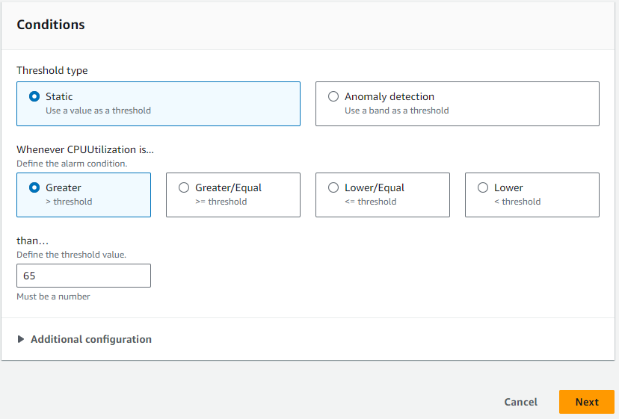
TASK – ALARMS
Enter threshold value 65 and click Next

Slide 19
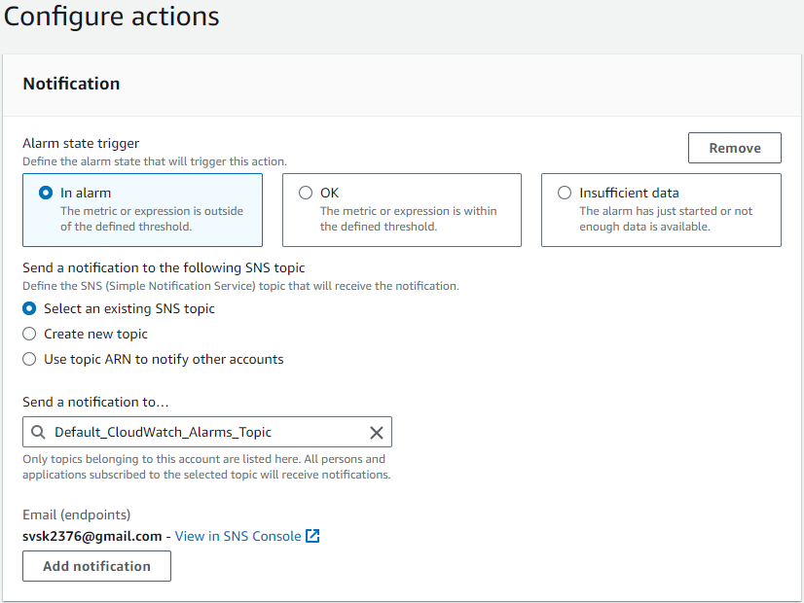
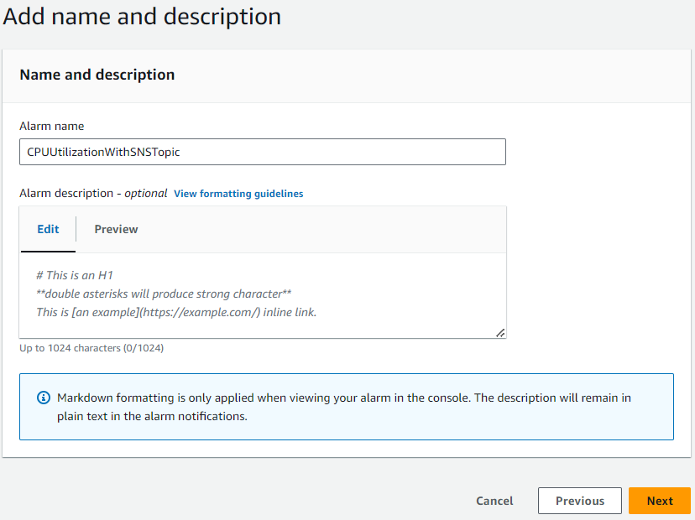
TASK – ALARMS
Give it a name and click on Next
Create a new SNS topic. It will send mail once the CPU Utilization reaches 65%.
Provide a mail ID
Keep the remaining settings as it is and click on Next
Review the settings and Create alarm

Slide 20
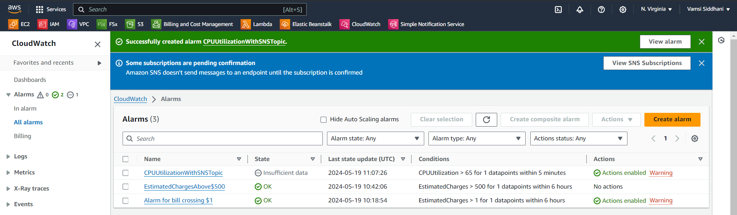
TASK – ALARMS
Alarm is created. Let’s go and subscribe this SNS Topic.
Open your mail and accept this subscription.

Slide 21
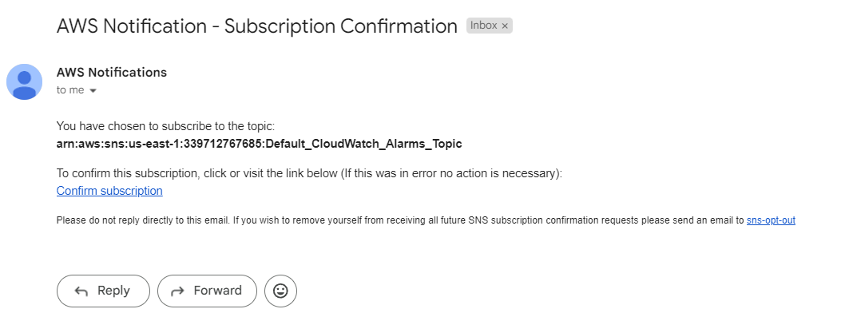
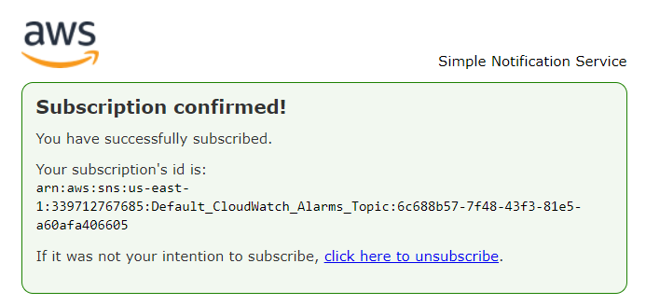
TASK – ALARMS
Click on Confirm
Subscription Confirmed

Slide 22
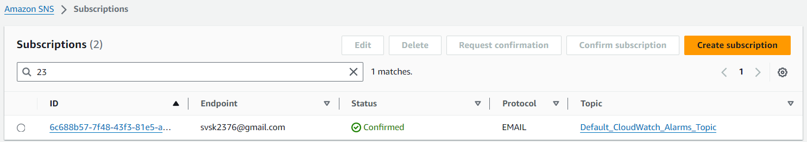
TASK – ALARMS
It is reflected in IAM Dashboard.
Whenever the CPU Utilization crosses 65%, it notifies the subscribed user by sending an e-mail.
This completes our assignment.

Slide 23
Summary
Created an EC2 instance. Created a CloudWatch dashboard that lets the user to check the CPU utilization and networking for that EC2 instance.
Created a CloudWatch billing alarm that goes off when the estimated charges go above $500.
Logged in to User1 (Dev1) and verified that it is working as expected.

Slide 24

Thank You.

